Slide 1
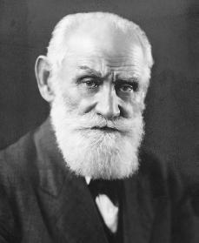
The Psychology of Learning
Classical Conditioning

Slide 2
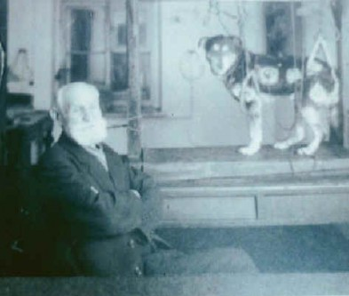
Classical Conditioning

Slide 3
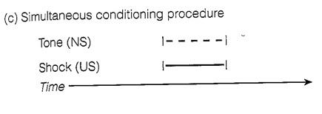
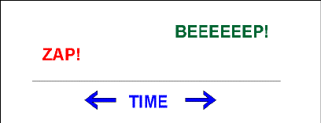
Classical Conditioning Procedures
Backward Conditioning

Slide 4
Classical Conditioning
The Intensity & Duration of CS & US affect conditioning
All CS’s are NOT equally conditionable
Biological predispositions matter!
Vicarious Classical Conditioning
Application of Classical Conditioning to everyday life:
Food Aversions (Garcia Effect)
Phobias
Sexual Fetishes
Racial Prejudice
Interpersonal Attraction

Slide 5
Classical Conditioning in Everyday Life

Slide 6
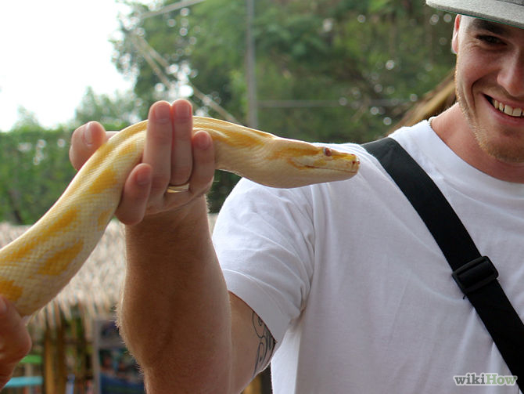
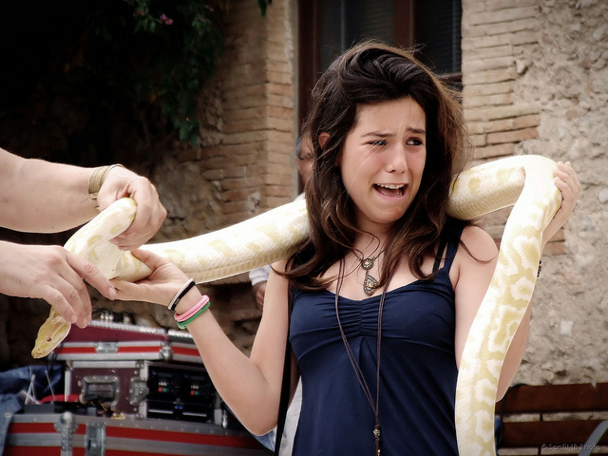
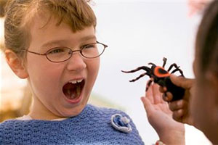
Phobia Formation

Slide 7
Classical Conditioning Terminology
Conditioned Inhibition
Second Order Conditioning
Inhibition of Delay
Blocking
Discrimination & Generalization
Extinction
Spontaneous Recovery

