Slide 1
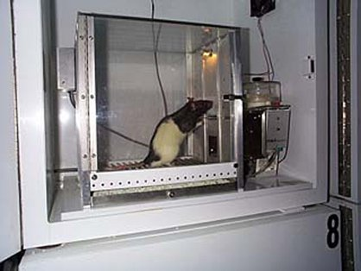
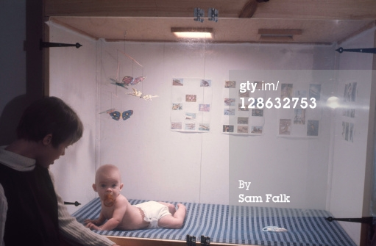
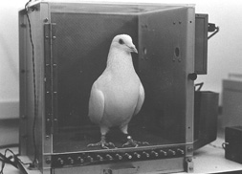
Operant Conditioning
B. F. Skinner

Slide 2
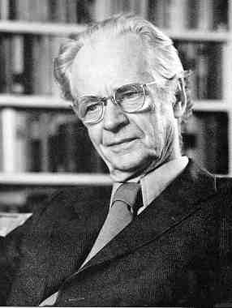
B. F. Skinner (1904-1990)
Pioneered the
Concept of
Reinforcement

Slide 3
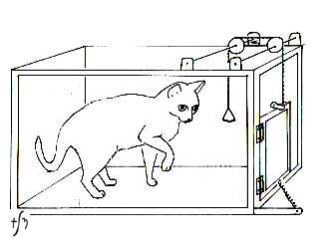
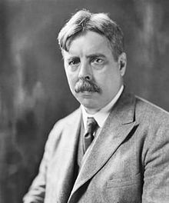
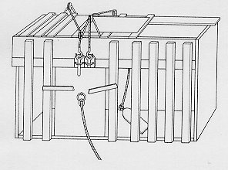
Thorndike’s “Law of Effect”
An act may be altered in its strength by its consequences”
E.L. Thorndike
Thorndike's Puzzle Box

Slide 4
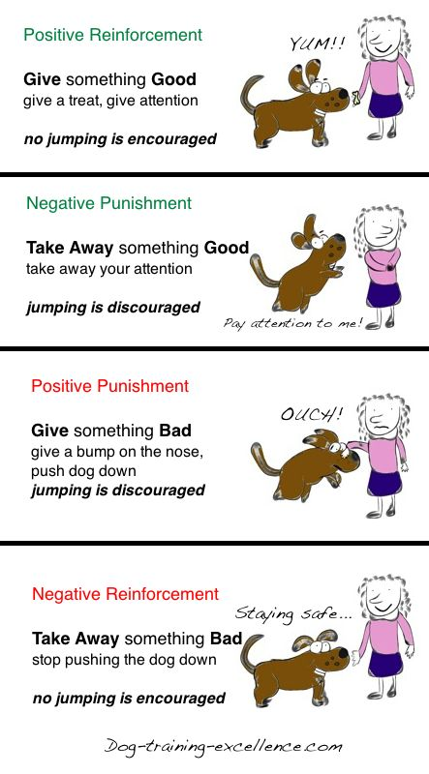
The Concept of Reinforcement

Slide 5
Shaping of Behavior through Operant Conditioning

Slide 6
Schedules of Reinforcement
Continuous Reinforcment
Intermittent Reinforcement
Interval Schedules
Fixed Interval (FI)
Variable Interval (VI)
Ratio Schedules
Fixed Ratio (FR)
Variable Ratio (VR)

Slide 7
Operant Conditioning Terms:
Discriminative Stimulus
Extinction
Generalization
Superstitious Behavior
Chaining
Secondary Reinforcement
Biological Constraints on Operant Conditioning

